Slide 1
Ecological Factors and Ecological adaptations

Slide 2
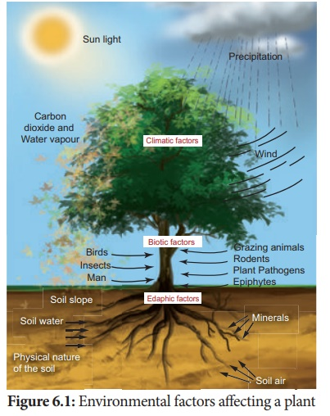

Slide 3
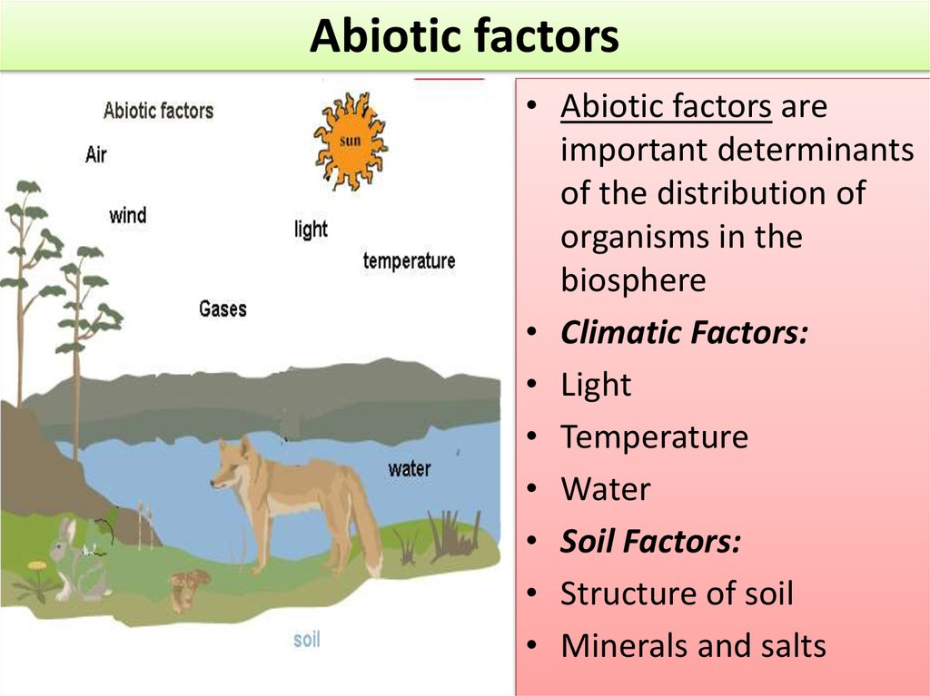

Slide 4
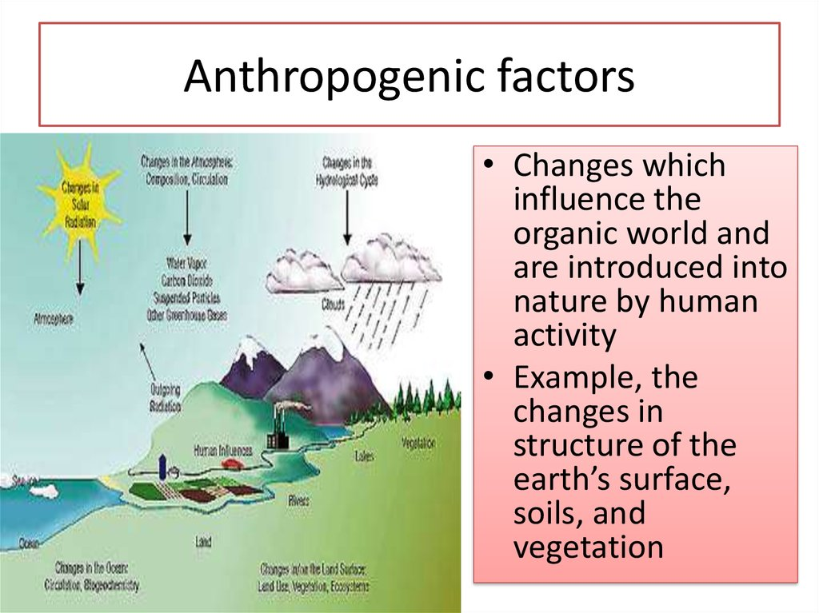

Slide 5
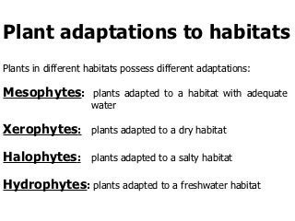

Slide 6
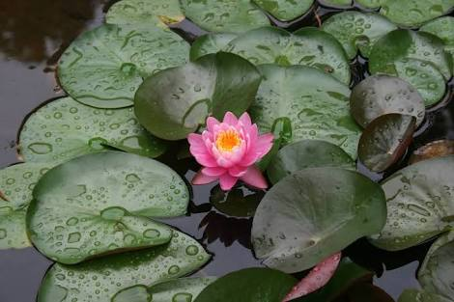
Hydrophyte plant adaptation

Slide 7
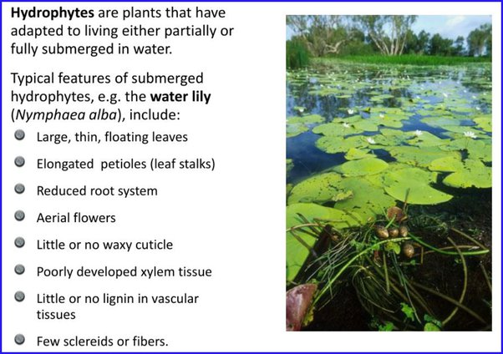

Slide 8
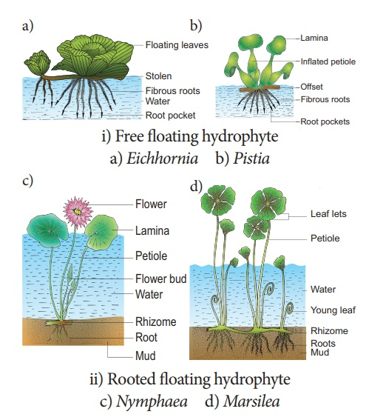

Slide 9
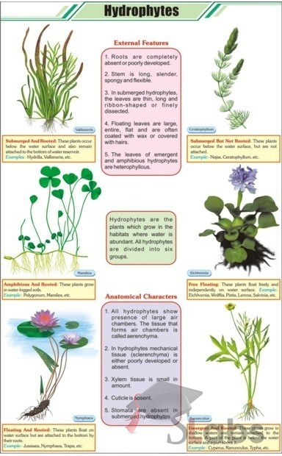

Slide 10
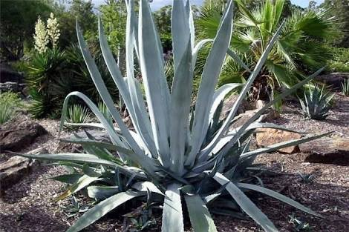
Xerophytes plant adaptation

Slide 11
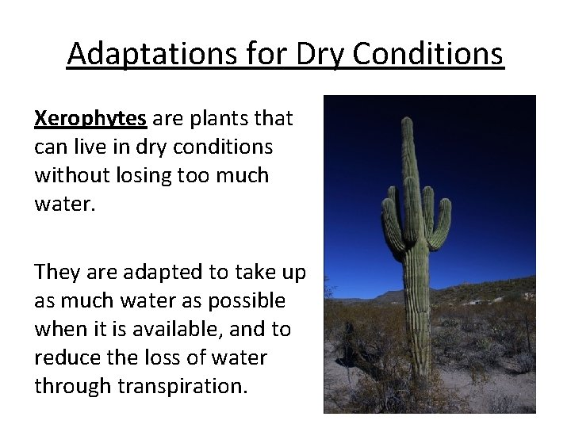

Slide 12
On the basis of their morphological, physiology and life cycles, the xerophytes can be grouped into three categories.
1. Ephemerals: They are drought escapers or drought evaders found in the habitatsof prolonged dry season. Eg: Solanum xanthocarpum, Echinops echinala etc.
2. Succulents. Such plants are called as drought resisting plants. The succulents are able to store large amount of water in their bodies. Eg: Stem succulents :Opuntia,Euphorbia etc.
Leaf succulents : Agave, Bryophylluin etc.
Root succulents : Asparagus, Ceiba parviflora etc.

Slide 13
Non -succulents plant : These are the true xerophytes because they experience dryness both internal and external. They are perennials and are characterised by many morphological and biological modifications, which enable them to withstand dry condition.
Eg:Acacia nilotica,Nerium etc.

Slide 14
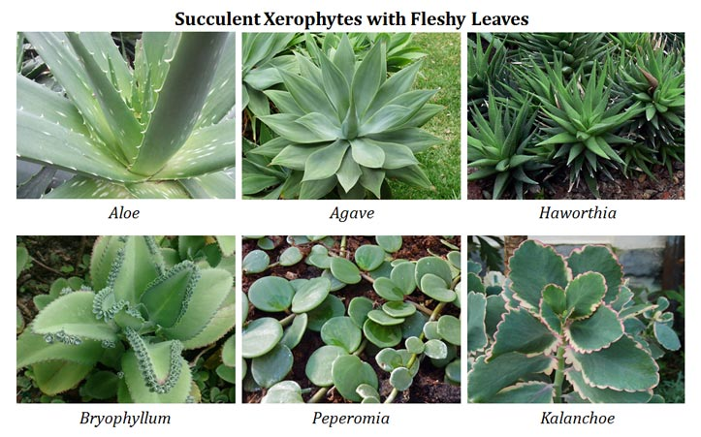

Slide 15
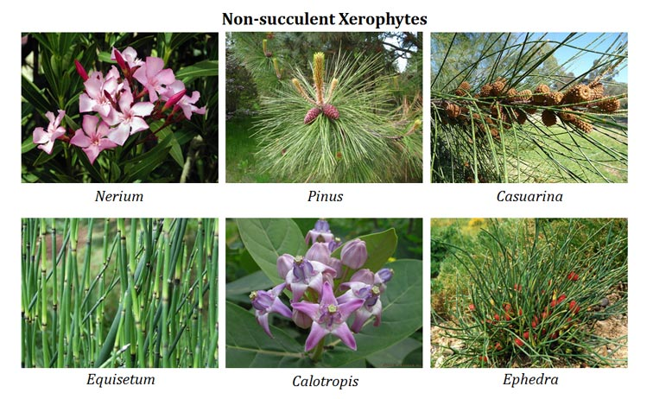

Slide 16
